Slide 1
SEN455
SOFTWARE QUALITY ASSURANCE
LECTURE # 1
INTRODUCTION

Slide 2
Instructor Information
Course Instructor:
Dr. Faheem Shaukat
Assistant Professor
Email:
faheem@iqraisb.edu.pk
Office hours:
Monday-Tuesday, 12:00 - 02:00PM

Slide 3
Course Information
Introduction
The purpose of the course is to introduce fundamental notions of software quality and the techniques used to build and check quality in software systems. A particular emphasis is placed on quantitative assessment of software quality and quality control using software testing techniques.
Learning Outcomes
By the end of this course, students should have a good grasp of software quality, Software Quality Assurance, Configuration management, Static Testing techniques, White box testing and Black box testing techniques, Software metrics and models, Debugging, Quality Management, Process Improvement and Cleanroom Software Engineering.

Slide 4
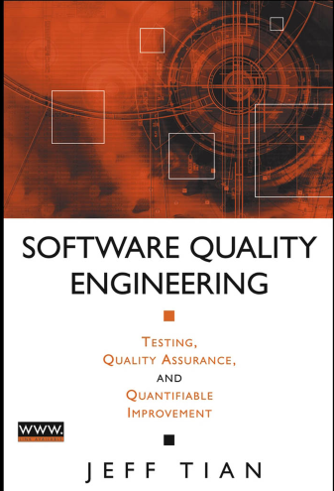
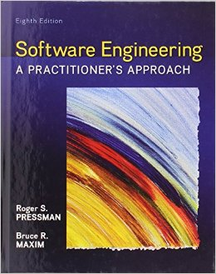

Books and Resources
  Software Quality Engineering, 6th Edition by Jeff Tian
  Software Engineering, A practitioner’s approach, 8th Edition by Roger S. Pressman

Slide 5
Reference Books
Recommended Text Books
Software Quality Engineering by Jeff Tian,
ISBN# 0471713457
Reference Books
Software Testing & Continuous quality improvement (2nd Edition) by William Lewis ISBN# 1420080733
The Art of Software Testing (2nd Edition) Glenford Myers ISBN# 0471043281
Software Testing and Quality Assurance, Theory and Practice: 2008, Kshirasagar Naik, Priyadarshi Tripathy
ISBN# 0471789119

Slide 6

Links and Reference Material
http://www.onestoptesting.com/
http://www.qastreet.com/
http://www.computer.org
http://www.springer.com
http://portal.acm.org

Slide 7
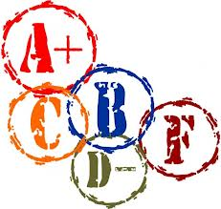
Grading Criteria
Grading
  Mid Terms - 25%
  Final Term - 40%
  Quiz - 10 %
  Assignment - 10 %
  Semester Project - 15%

Slide 8
Software Quality
Quality
Quality Engineering
Quality Types
Quality Control vs Quality Assurance
Different views of Quality
Quality Models
Cost of Quality

Slide 9
What is quality?
Quality, simplistically, means that a product should meet its specification.
This is problematical for software systems
  There is a tension between customer quality requirements (efficiency, reliability, etc.) and developer quality requirements (maintainability, reusability, etc.);
  Some quality requirements are difficult to specify in an unambiguous way;
  Software specifications are usually incomplete and often inconsistent.

Slide 10
Quality Engineering
Software quality assurance (SQA) consists of a means of monitoring the software engineering processes and methods used to ensure quality.

Slide 11
DEFINING QUALITY
Perfection
Consistency
Eliminating waste
Speed of delivery
Compliance with policies & procedures
Providing good, usable products
Doing it right the first time
Delighting or pleasing customers
Total customer service & satisfaction

Slide 12
Quality Types
Functional Quality — a measure of what the software does vs. what it’s supposed to do
Non-Functional Quality – a measure of how well it does it vs. how well it’s supposed to do it
Latent Quality — a measure of how well it will continue to do it in the future

Slide 13
Quality Types
Process quality: Software processes implement best practices of software engineering in an organizational context. Process quality expresses the degree to which defined processes were followed and completed.
Product quality: Software products are the output of software processes. Product quality is determined by the degree to which the developed software meets the defined requirements.
Quality in use: Quality in use addresses the degree to which a product is fit for purpose when exposed to a particular context of use.

Slide 14
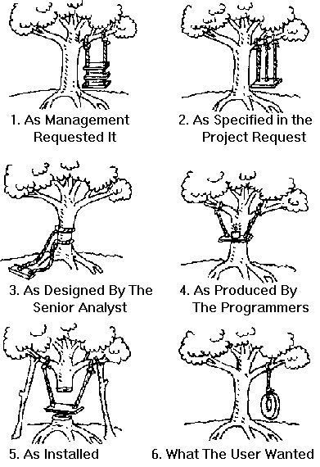
Different Views of Quality
Transcendental View
User View
Manufacturing View
Product View
Value based View

Slide 15
Quality Models
Standard quality models
  McCall
  ISO/IEC 9126
  IEEE
Application or company specific quality models
  FURPS
  GQM Approach

